Slide 1

Keyword Prediction

Slide 2

Problem statement
Take a question from user and tag it with different topics that it might be related to, like C++, Java, Webforms etc.

Slide 3

What is stack overflow ?
The largest online community of developers
Every programmer uses in their workflow.
Automatically tags each question

Slide 4

Stack overflow has more than seven million registered users.
The platform caters exchange of over 10 million questions in a year.

Slide 5
The Business Problem
Automatically recommend tags related to the subject of the question
Use tags to connect questions to users who can answer

Slide 6
Why are tags important ?
Stack overflow detects the question tag and routes questions to subject matter expert

Slide 7

Business Value
It is vital to send the right question to the right users
Predicting tag has high value to increase user experience.
Sending java related questions to PHP developer will be a big miss

Slide 8
Mapping to machine learning scenario
Tag 1
Data
Tag 2
……
……
……
……
Tag n
One model for each tag
If there are 10000 possible tags, we can build 10000 binary classification models to predict each of the tags.

Slide 9

High level requirements
Microsoft Azure VM for compute (8 core 32Gb ram)
Visual studio code for environment

Slide 10
Python libraries overview
Plotting – Matplotlib, seaborn
Data processing – Pandas, NumPy
Handling > 5Gb datasets – Dask, Dask_ml, Datatable (out of memory computation and distributed computing)
Natural language processing – Nltk for stop-words, stemmer and cleaning
Feature engineering – sklearn feature extraction
Feature selection – sklearn feature selection chi-square test
Multilabel prediction – sklearn multioutput and classifier chains, SVM, logistic regression
Classification - sklearn logistic regression, SVM

Slide 11

Special use cases – Data Table
Supports out-of-memory datasets.
Multi-threaded data processing
It is a toolkit for performing big data (up to 100 GB) operations on a single-node machine, at the maximum possible speed.
Is quite similar to pandas, but focus more on speed and big data support.

Slide 12
Special use cases – Dask
Free, open-source library for parallel computing
Use to scale data science and machine learning workflows
If you have data that is larger than what is in memory, you can utilize Dask to scale up your workflow
to employ all the cores on your local workstation, or even scale out to the cloud.

Slide 13
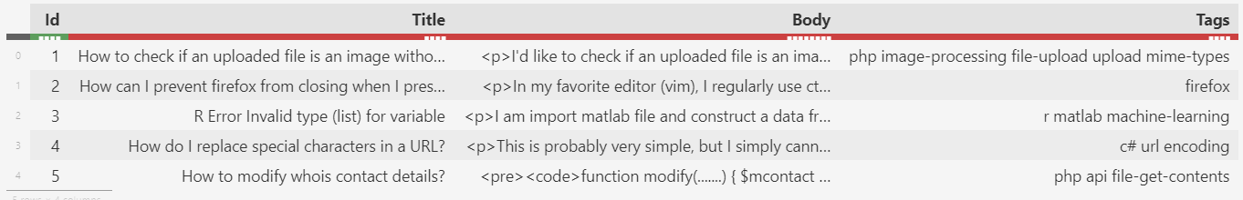
Dataset Overview
Download url: https://www.kaggle.com/c/facebook-recruiting-iii-keyword-extraction/overview
There are 6 million rows in this dataset
Size of csv file is 8Gb

Slide 14
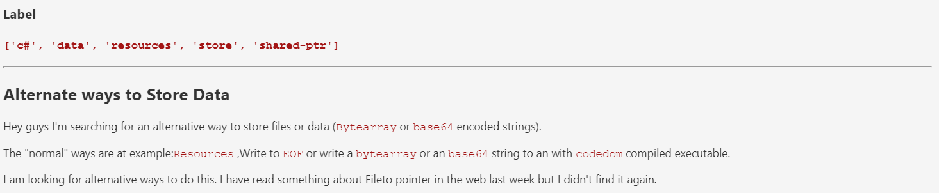
Example of question

Slide 15

Data Cleaning

Slide 16
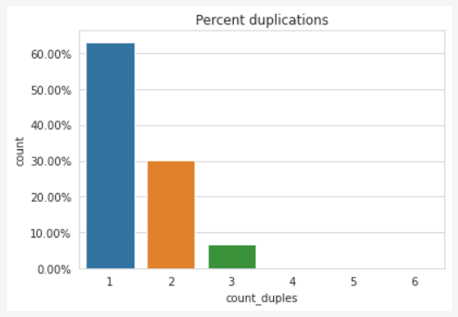
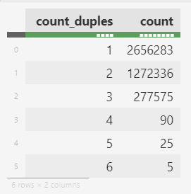

Removing duplicates
There were 2 million duplicates in the dataset, or 35 percent
Around 30 percent of the questions had at least 1 duplicate
Very few, around 4 percent, of the questions had 2 or more duplicates

Slide 17

Analyzing tags

Slide 18
Preprocessing step - Vectorize the tags
C++ pointers
Java
C++ | Pointers | .. | Java | .. | ….
1 | 1 | .. | 0 | .. | ….
0 | 0 | .. | 1 | .. | ….
4.2 million questions
42000 unique possible tags for each question

Slide 19
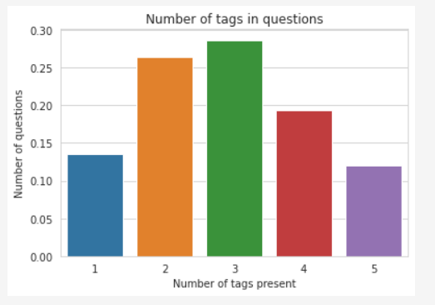
Tags per question
Observations -
30 percent questions have 3 tags
Around 13 percent questions have just 1 tag
Around 30 percent questions have more than 3 tags
So, we are looking at top 5 predictions from our multilabel classifier

Slide 20
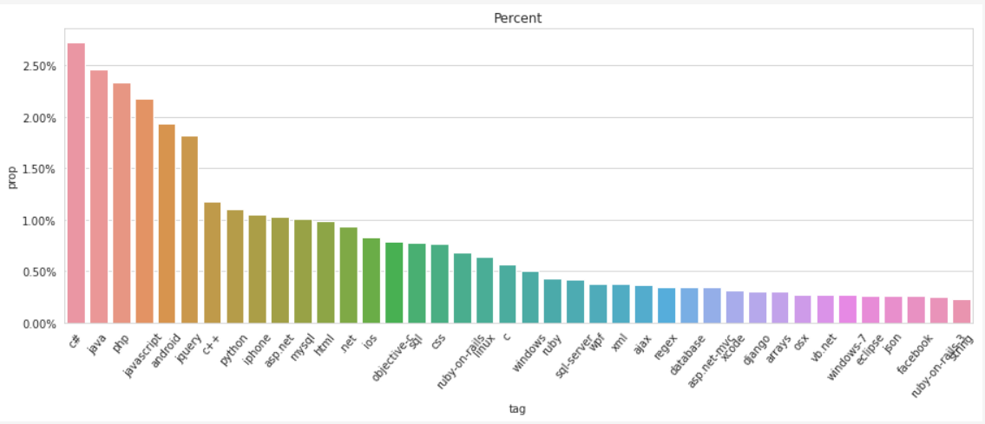
Tags frequency

Slide 21
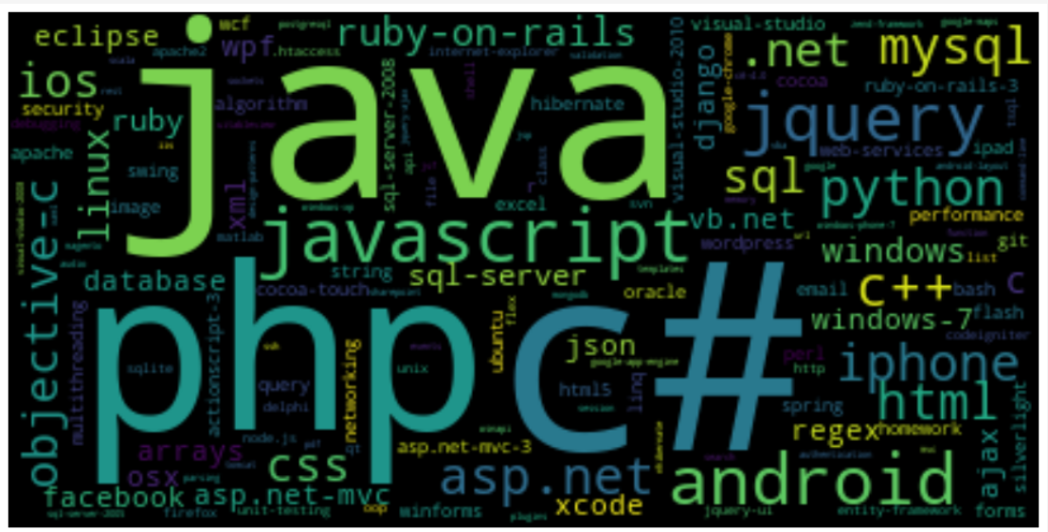

Slide 22
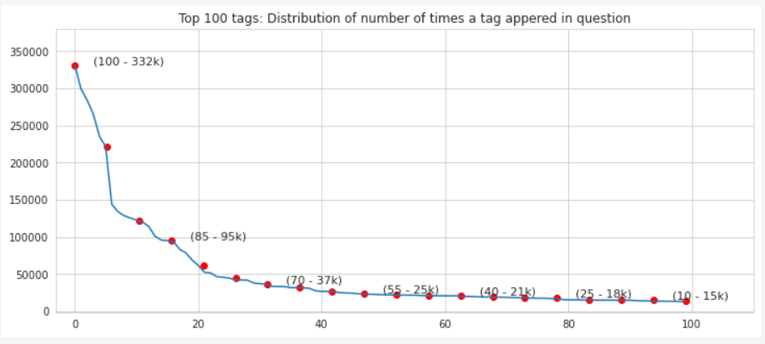
Distribution of tag frequency for top 100 tags
Observations -
Most frequent tag occurs 300k times
Only 14 tags occur at least 100k times
Only 153 tags occur at least 10k times

Slide 23
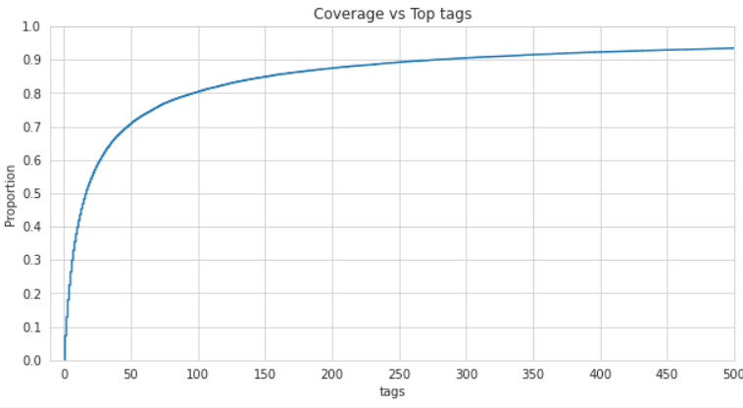
Dataset coverage
This plot most certainly tells that:
Predicting top 500 tags will give a coverage over 90 percent of the questions in dataset
Predicting only top 100 tags will give us coverage over 80 percent of the questions
Predicting only top 50 tags gives coverage over 70 percent of all questions in dataset

Slide 24

After analyzing coverage, we will only be predicting 50 tags that will cover 70 percent of the overall dataset.
In production, we can predict 5000 tags to cover 99 percent data.

Slide 25
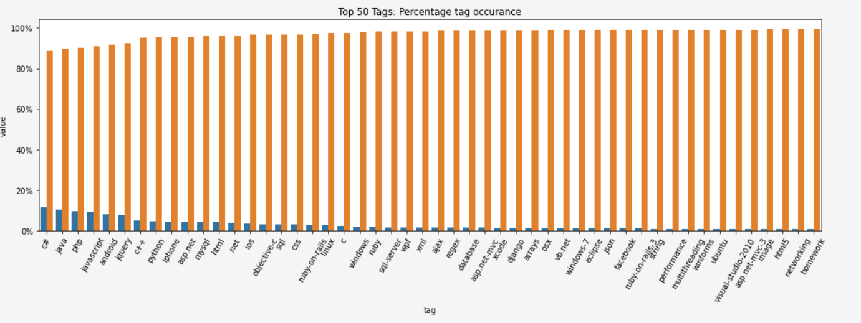
Tag class proportions
All the tag classes are highly imbalanced

Slide 26
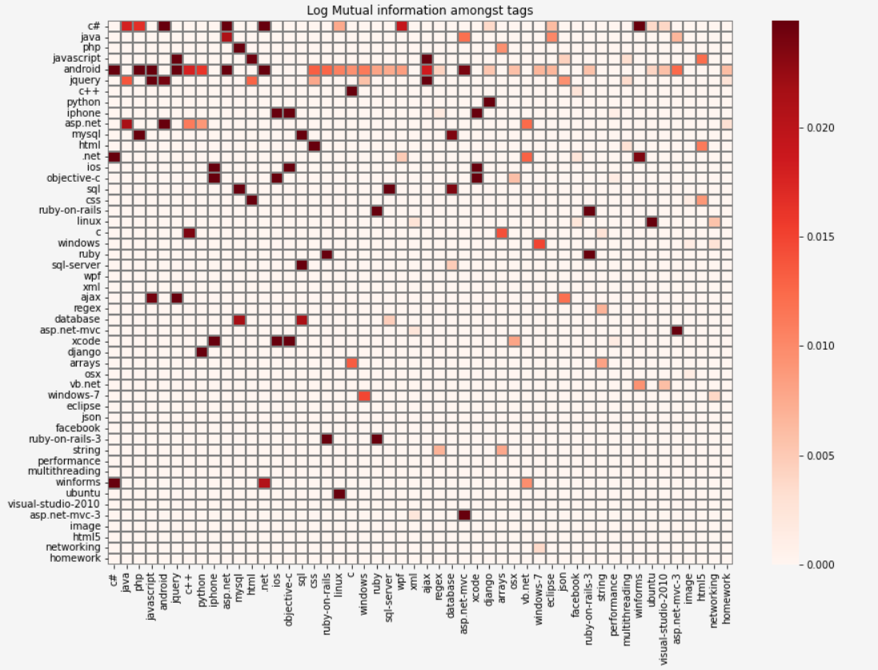

Slide 27
…
Some Relationships discovered
1. ubuntu --> (linux)
2. regex --> (string)
3. sql --> (database, sql-server)
4. windows-7 --> (windows)
5. arrays --> (c)
6. django --> (python)
7. ajax --> (jquery)
8. css --> (html)

Slide 28

`Until now`, the tag data has been cleaned and is now ready for further analysis.
Next steps, broadly –
Process title and body to create features
Apply multilabel logistic regression to the dataset
Evaluate results

Slide 29

Text Data
Unstructured form of data
Knowledge needs to be extracted by creative feature engineering techniques

Slide 30

Process Flow

Slide 31







Process tags
TRAIN
TRAIN
Train test
split
TEST
Feature creation and selection layers
DATA
Feed to models for training
TEST
Sample 500k datapoints for training and testing
….
Process text
Evaluate model using test
50 models for 50 tags
Evaluation layer

Slide 32
Cleaning text data

Slide 33
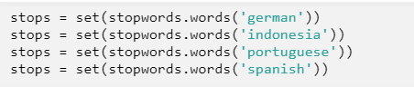
Terminology 101 - Stopwords
Text may contain stop words like ‘the’, ‘is’, ‘are’
Stop words can be filtered from the text to be processed
There is no universal list of stop words in NLP research, however the NLTK module contains a list
NLTK stop words - Python Tutorial (pythonspot.com)

Slide 34
Terminology 101 – Word stemming
Process of cutting common prefixes or suffixes that occur at the beginning or ending of a word
Useful NLP technique to clean and reduce the size of input
Word | Stem
Intention | Intent
Intentionally | Intent
Intentfully | Intent
NLTK stop words - Python Tutorial (pythonspot.com)

Slide 35
Other cleaning techniques
Removing HTML tags
Separating code from question body
Converting text to lowercase
Remove special characters

Slide 36
Feature Engineering

Slide 37
Technique 1: Bag of Words
This | That | Sentence | Is | Another | a
1 |  | 1 | 1 |  | 1
 | 1 | 1 | 1 | 2
This is a sentence
That is another another sentence
Create a vocabulary of all unique words in dataset
Record a count of each word
Does not record the order
, or context of each word .. New vs New York

Slide 38
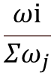
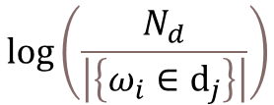
Technique 2: TF-IDF score
TERM FREQ
DOCUMENT FREQ
$$\frac{ωⅈ}{Σω_{j}}$$
$$\log\left(\frac{N_{d}}{\left|\left\{ω_{i}∈ⅆ_{j}\right\}\right|}\right)$$
Probability of finding a word in current sentence
How important is
The word overall dataset ?
Create a vocabulary of all unique words in dataset
Record Tf-idf score of each word
Does not record the order
, or context of each word .. New vs New York

Slide 39

Feature selection

Slide 40
After converting text to Tf-Idf vectors, the shape of the training data is 400k * 80k
That is there are 80000 features

Slide 41
Chi-square test
Not every feature is important, and we must only keep the best. The solution is to measure the importance of each feature with respect to the target tags.
The Chi-Square test is a statistical procedure for determining the difference between observed and expected data. This test can also be used to determine whether it correlates to the categorical variables in our data. It helps to find out whether a difference between two categorical variables is due to chance or a relationship between them.
https://www.simplilearn.com/tutorials/statistics-tutorial/chi-square-test#:~:text=What%20Is%20a%20Chi-Square%20Test%3F%20The%20Chi-Square%20test,correlates%20to%20the%20categorical%20variables%20in%20our%20data.

Slide 42
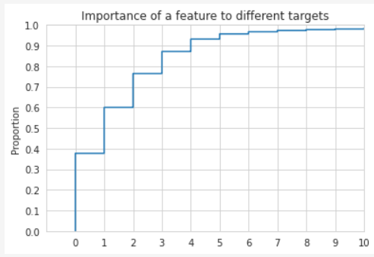
Chi Square test results
After considering only the statistically significant features from chi-square test, we were able to discard 40 percent of the 80k features as they were not of any relevance to any target variable

Slide 43

Evaluation metrics

Slide 44
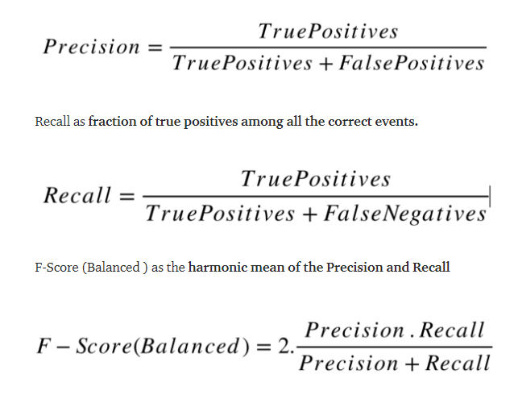
Precision, recall and F1-score
Precision is about how precise are predictions, if I said it will rain 14 days in a month, but it only rained 7 days, then precision is 50 percent.
Recall is about how good memory is, in sense that if it rained 10 days in a month and model could predict 7 of the 10 rainy days correctly, then recall is about 70 percent.
F1 score is when we want a trade-off and want to try to maximise both recall and precision. Mathematically, F1 score is the geometric mean of recall and precision.

Slide 45
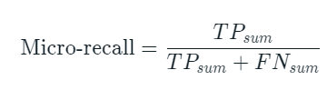
Micro-averaging for evaluation
Micro-averaging is performed by first calculating the sum of all true positives and false positives, over all the classes. Then we compute the recall for the sums.

Slide 46
Feeding data to models

Slide 47
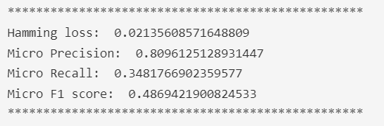
Model 1
50 independent Logistic Regression models
Model parameters –
Alpha = 0.0001 (default)
Class weights = None

Slide 48
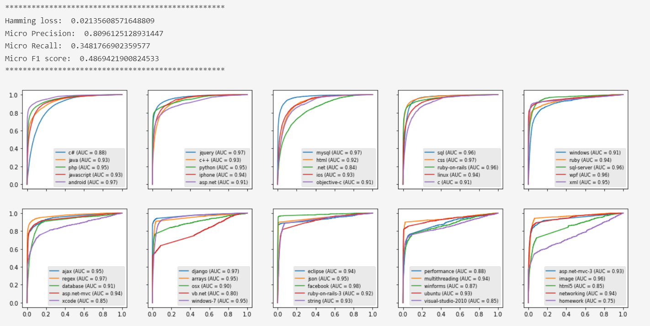

Slide 49
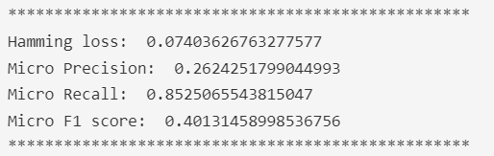
Model 2
50 independent Logistic Regression models
Model parameters –
Alpha = 0.0001 (default)
Class weights = “balanced”
Minority classes are given more weightage

Slide 50
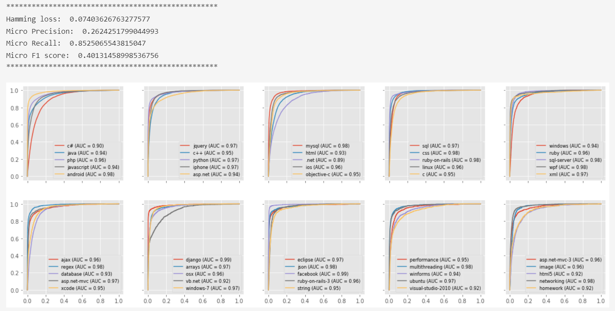

Slide 51
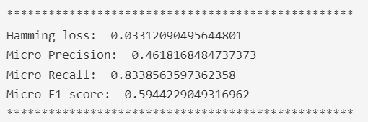
Model 3
50 independent Linear support vector machines
Model parameters –
Class weights = “balanced”
Minority classes are given more weightage

Slide 52
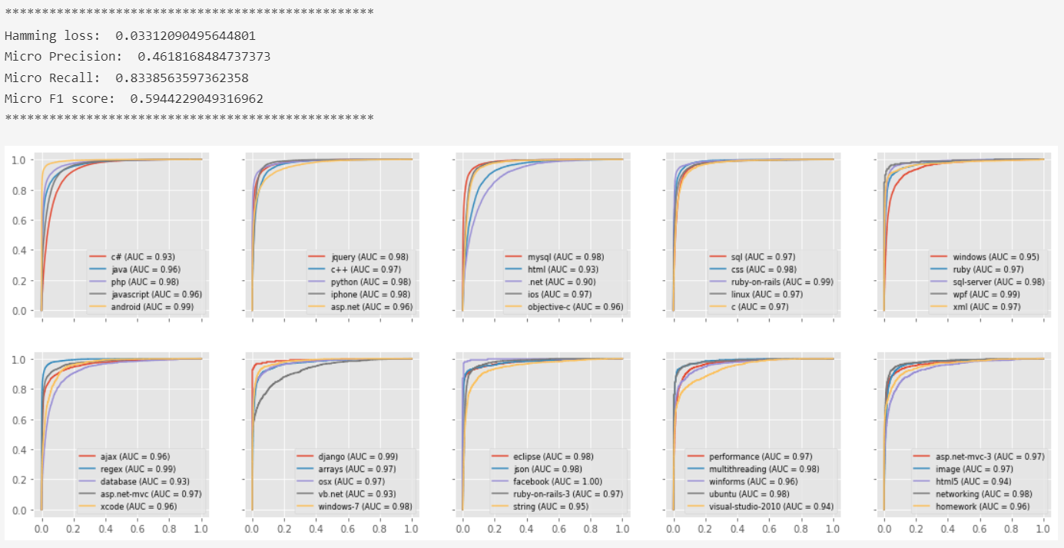

Slide 53
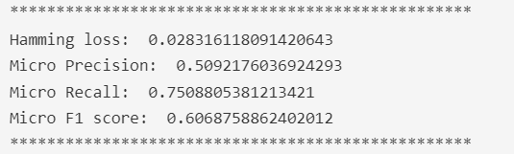
Model 4
50 Linear SVM models linked via classifier chains
Model parameters –
Class weights = “balanced”
Minority classes are given more weightage

Slide 54
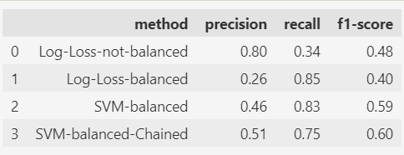
Observations:
There is a tradeoff between precision and recall
The best model of all tested is a chained SVM model with a recall score of 0.75 and precision of 0.50

Slide 55
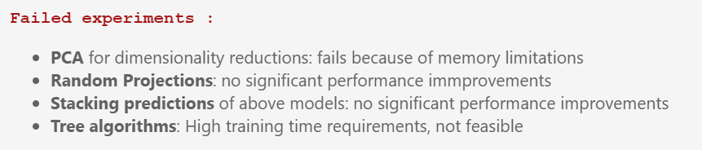
Other experiments

Slide 56
Questions

